Slide 1
Chapter 4
Dependencies & Normal Forms

Slide 2
Learning Objectives
Overview of some informal design guidelines for relation schemas
Understanding functional dependencies
Recognizing normal forms based on primary keys
Defining and differentiating second and third normal forms
Understanding Boyce-Codd normal form

Slide 3
Outline
Informal design guidelines for relation schemas
Functional dependencies
Normal forms based on primary keys
General definitions of second and third normal forms
Boyce-Codd normal form

Slide 4
Introduction
Levels at which we can discuss goodness of relation schemas
  Logical (or conceptual) level
  Implementation (or physical storage) level
Approaches to database design:
  Bottom-up or top-down

Slide 5
Informal Design Guidelines for Relation Schemas
Measures of quality
  Making sure attribute semantics are clear
  Reducing redundant information in tuples
  Reducing NULL values in tuples
  Disallowing possibility of generating spurious tuples

Slide 6
Informal Design Guidelines for Relation Schemas
Spurious Tuples
  When we combine two tables into one, we call it a join and it is denoted by ⨝.
  Spurious Tuples are those rows in a table, which occur as a result of joining two tables in the wrong manner
  They are extra tuples (rows) that might not be required.
  If a relation is denoted by R, and its decomposed relations are denoted by R1, R2, R3…Rn, then, the condition for not getting any Spurious Tuple is denoted by,
    R1 ⨝ R2 ⨝ R3 .... ⨝ Rn = R
  Whereas the condition for getting Spurious Tuples is denoted by,
    R ⊂ R1 ⨝ R2 ⨝ R3 .... ⨝ Rn

Slide 7
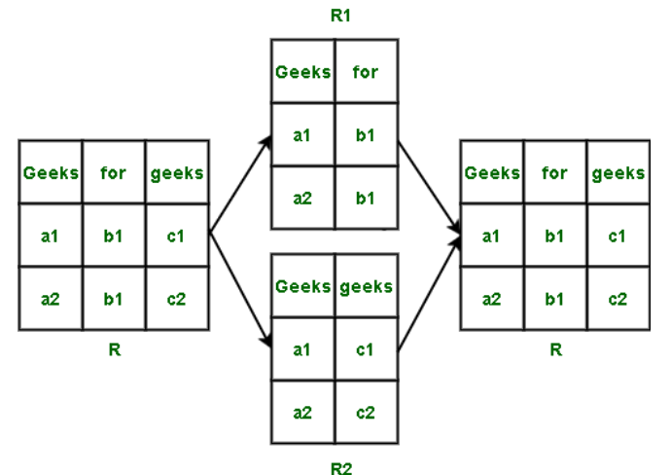
Informal Design Guidelines for Relation Schemas
Spurious Tuples
  Full Outer Join ( R1 ⟗ R2 = R No Spurious Tuple exists)

Slide 8
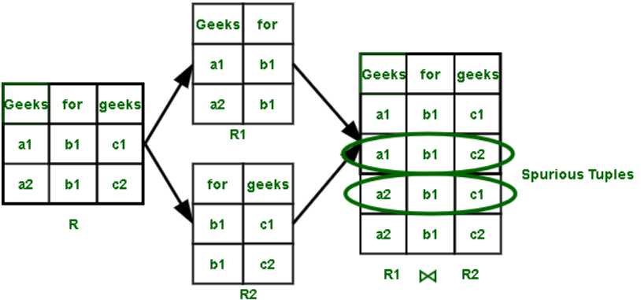
Informal Design Guidelines for Relation Schemas
Spurious Tuples
  Notation:(R ⊂ R1 ⨝ R2, Spurious Tuple exists)

Slide 9
Imparting Clear Semantics to Attributes in Relations
Semantics of a relation
  Meaning resulting from interpretation of attribute values in a tuple (entity name Student)
Easier to explain semantics of relation
  Indicates better schema design

Slide 10
Redundant Information in Tuples
Grouping attributes into relation schemas
  Significant effect on storage space
Storing natural joins of base relations leads to update anomalies
Types of update anomalies:
  Insertion
  Deletion
  Modification

Slide 11
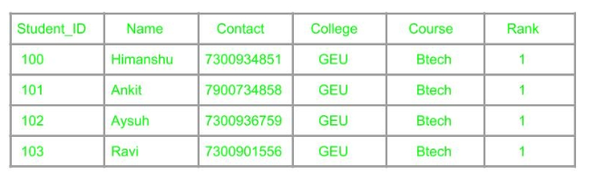
Redundancy
means having multiple copies of same data in the database.
Arises when a database is not normalized.
Suppose a table of student details attributes are: student Id, student name, college name, college rank, course
As it can be observed that values of attribute college name, college rank, course is being repeated which can lead to problems
  Insertion anomaly, Deletion anomaly, and Updation anomaly.

Slide 12
Anomalies
Typically occur in poorly structured files.
Problems arise when two different kinds of data, like salesperson and customer data are merged into one file.
There are three types of anomalies that occur when the database is not normalized. These are –
  Insertion
  update
  and deletion anomaly.
4-<number>

Slide 13
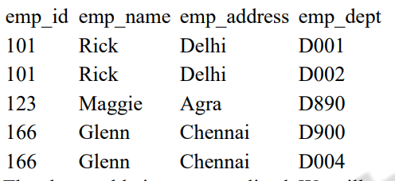
Anomalies (cont..)
Example: Suppose a manufacturing company stores the employee details in a table named employee that has four attributes: emp_id for storing employee’s id, emp_name for storing employee’s name, emp_address for storing employee’s address and emp_dept for storing the department details in which the employee works. At some point of time the table looks like this:
4-<number>

Slide 14
Anomalies (cont..)
Update anomaly: In the above table we have two rows for employee Rick as he belongs to two departments of the company. If we want to update the address of Rick then we have to update the same in two rows or the data will become inconsistent. If somehow, the correct address gets updated in one department but not in other then as per the database, Rick would be having two different addresses, which is not correct and would lead to inconsistent data.
4-<number>

Slide 15
Anomalies (cont..)
Insert anomaly: Suppose a new employee joins the company, who is under training and currently not assigned to any department then we would not be able to insert the data into the table if emp_dept field doesn’t allow nulls
4-<number>

Slide 16
Anomalies (cont..)
Delete anomaly: Suppose, if at a point of time the company closes the department D890 then deleting the rows that are having emp_dept as D890 would also delete the information of employee Maggie since she is assigned only to this department.
4-<number>

Slide 17
Guideline 2
Design base relation schemas so that no update anomalies are present in the relations
If any anomalies are present:
  Note them clearly
  Make sure that the programs that update the database will operate correctly

Slide 18
NULL Values in Tuples
May group many attributes together into a “fat” relation
  Can end up with many NULLs
Problems with NULLs
  Wasted storage space
  Problems understanding meaning

Slide 19
Guideline 3
Avoid placing attributes in a base relation whose values may frequently be NULL
If NULLs are unavoidable:
  Make sure that they apply in exceptional cases only, not to a majority of tuples

Slide 20
Goal — Devise a Theory for the Following
Decide whether a particular relation R is in “good” form.
In the case that a relation R is not in “good” form, decompose it into a set of relations {R₁, R₂, ..., R_{n}} such that
  each relation is in good form
  the decomposition is a lossless-join decomposition
    Lossless join decomposition is a decomposition of a relation R into relations R1, R2 such that if we perform a join of relation R1 and R2, it will return the original relation R
Our theory is based on:
  functional dependencies
  multivalued dependencies

Slide 21
Functional Dependencies (FDs)
What is Functional Dependency?
  Functional Dependency (FD) is a constraint that determines the relation of one attribute to another attribute in a Database Management System (DBMS).
  Functional Dependency helps to maintain the quality of data in the database.
  It is role to find the difference between good and bad database design.
  A functional dependency is denoted by an arrow “→”.
  The functional dependency of X on Y is represented by X → Y.

Slide 22
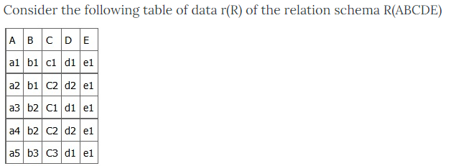
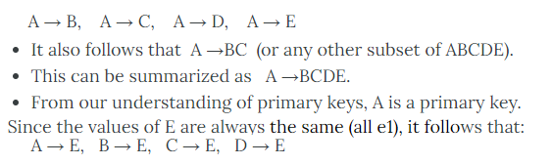
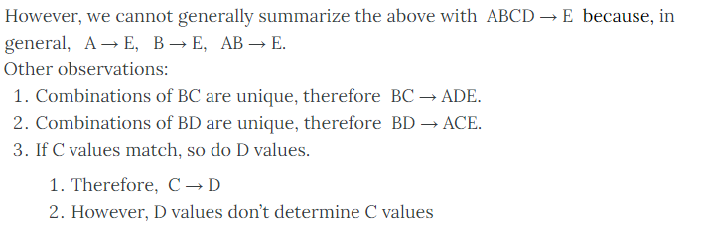
Functional Dependencies (FDs)

Slide 23
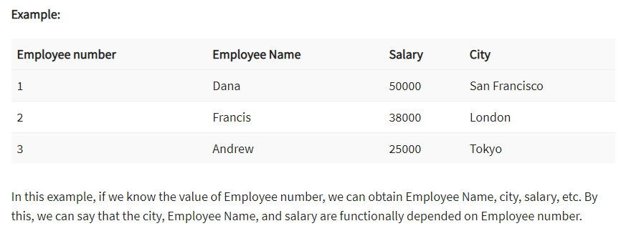
Functional Dependencies (FDs)

Slide 24
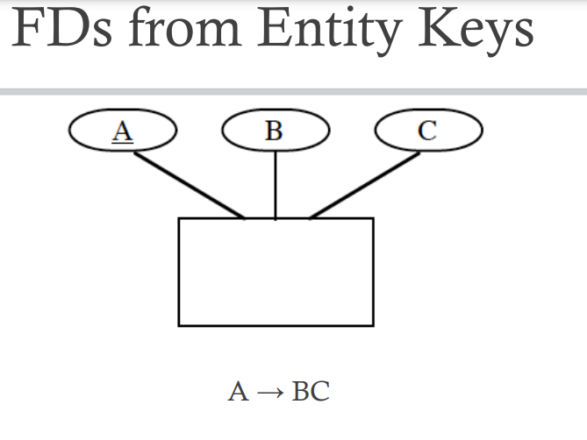
Functional Dependencies (FDs)

Slide 25
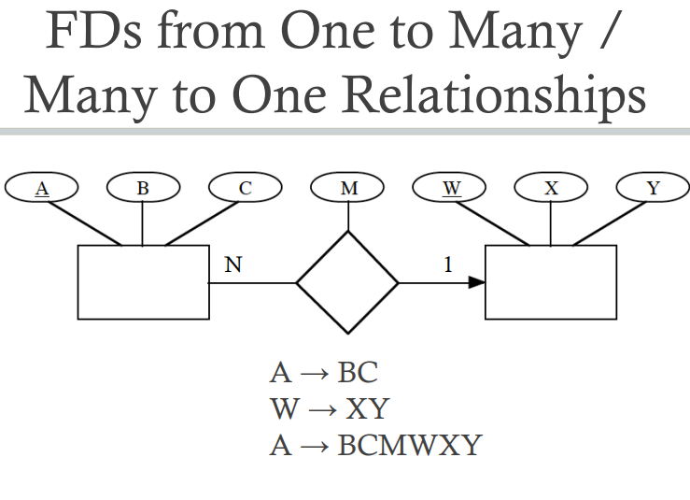
Functional Dependencies (FDs)

Slide 26
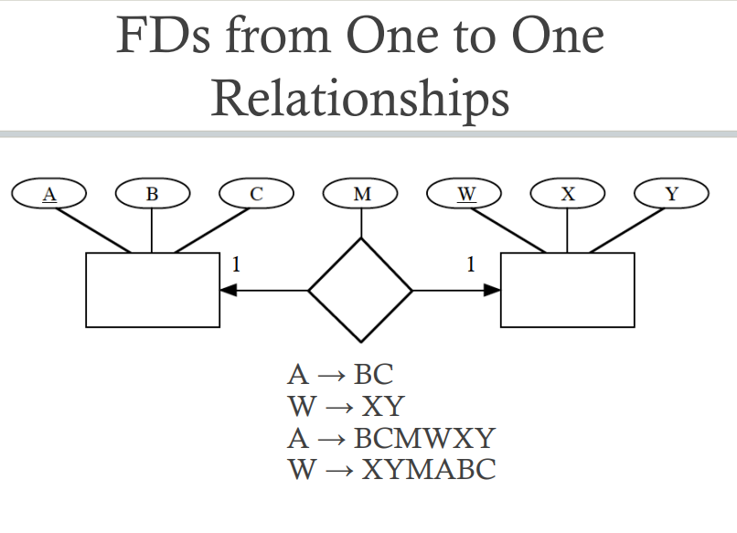
Functional Dependencies (FDs)

Slide 27
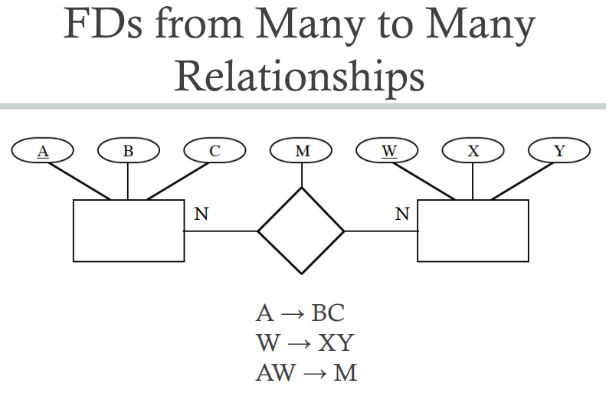
Functional Dependencies (FDs)

Slide 28
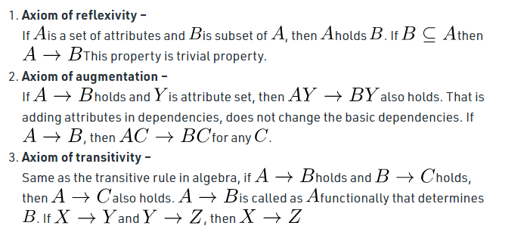
Functional Dependencies (FDs)
Key terms
  Axiom
    is a set of inference rules used to infer all the functional dependencies on a relational database.

Slide 29
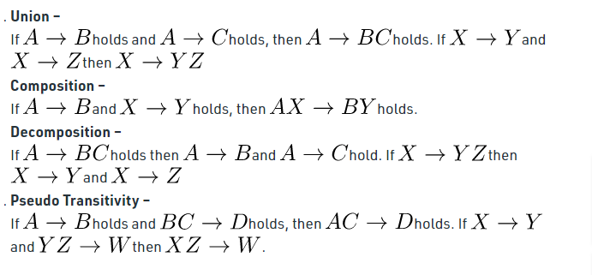
Functional Dependencies (FDs)
Key terms

Slide 30

Functional Dependencies (FDs)
Key terms
  Decomposition
    It is a rule that suggests if you have a table that appears to contain two entities which are determined by the same primary key then you should consider breaking them up into two different tables

Slide 31
Functional Dependencies (FDs)
Key terms
  Dependent
    It is displayed on the right side of the functional dependency diagram.
  Determinant
    It is displayed on the left side of the functional dependency Diagram

Slide 32
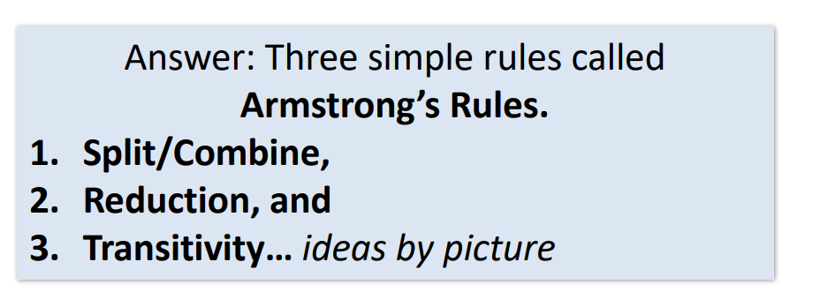
Functional Dependencies (FDs)

Slide 33
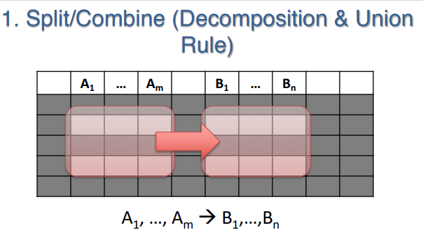
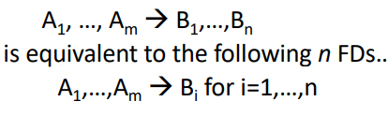
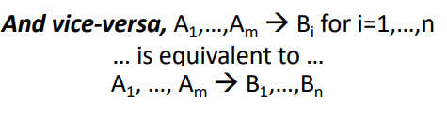
Functional Dependencies (FDs)

Slide 34
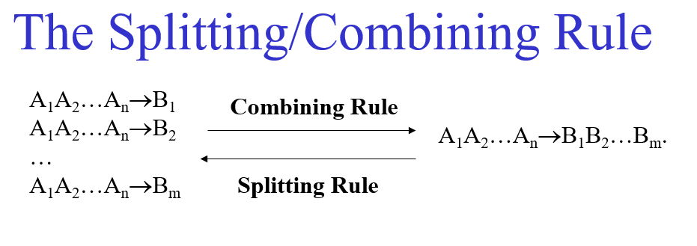
Functional Dependencies (FDs)

Slide 35
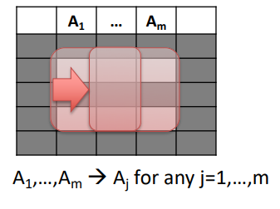
Trivial Dependencies
A functional dependency A₁A₂…A_{n}→B is said to be trivial if B is one of A’s.
  For example: title year →title is a trivial dependency.
We say that a dependency A₁A₂…A_{n}→B₁B₂…B_{m} is:
  Trivial if the B’s are subset of A’s.
  Nontrivial if at least one of the B’s is not among the A’s.
  Completely nontrivial if none of the B’s is also one of the A’s.
    If a FD A→B holds true where A intersection B is null
Thus title year → year length is nontrivial but not completely nontrivial.
The trivial dependency rule is: We can always remove from the right side of an FD those attributes that appear on the left.

Slide 36
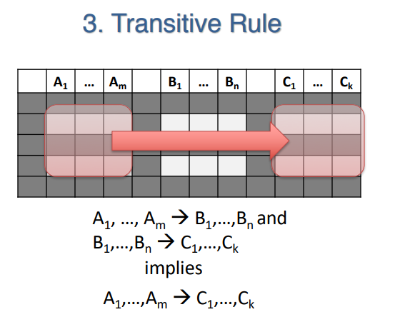

Slide 37
Computing the Closure of Attributes
There is a general principle from which all possible FD’s follow.
Suppose {A₁, A₂, …, A_{n}} is a set of attributes and S is a set of FD’s.
  Closure of {A₁, A₂, …, A_{n}} under the dependencies in S is the set of attributes B, which are functionally determined by A₁, A₂, …, A_{n} i.e.
    A₁A₂…A_{n}→B.
  That is A₁A₂…A_{n}→B follows from dependencies of S.
  We denote the closure of a set of attributes {A₁, A₂, …, A_{n}} by {A₁, A₂, …, A_{n}}⁺.

Slide 38
Computing the Closure of Attributes - Algorithm
Starting with the given set of attributes, repeatedly expand the set by adding the right sides of FD’s as soon as we have included their left sides.
Eventually, we cannot expand the set any more, and the resulting set is the closure.
  Let X be a set of attributes that eventually will become the closure. First we initialize X to be {A₁, A₂, …, A_{n}}.
  Now, repeatedly search for some FD in S:
  B₁B₂…B_{m}→C
  such that all of B’s are in the set X, but C is not. We then add C to X.
  Repeat step 2 as many times as necessary until no more attributes can be added to X. Since X can only grow, and the number of attributes is finite, eventually nothing more can be added to X.
  The set X after no more attributes can be added to it is the: {A₁, A₂, …, A_{n}}⁺.

Slide 39
Computing the Closure of Attributes - Example
Let’s consider a relation with attributes A, B, C, D, E and F. Suppose that this relation satisfies the FD’s:
AB→C,
BC→AD,
D→E,
CF→B.
What is {A,B}⁺?
Iterations:
  X = {A,B} Use: AB→C
  X = {A,B,C} Use: BC→AD
  X = {A,B,C,D} Use: D→E
  X = {A,B,C,D,E} No more changes to X are possible so X = {A,B}⁺.
The FD: CF→B cannot be used because its left side is never contained in X.

Slide 40
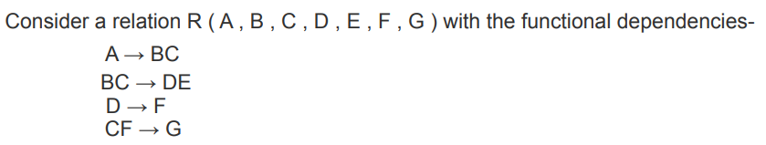
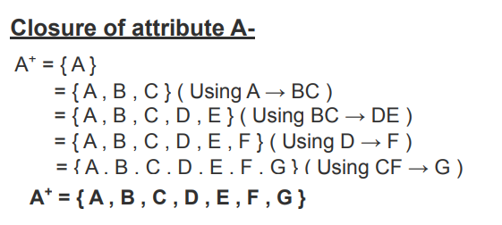
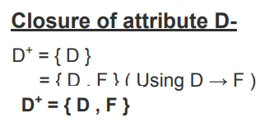
Computing the Closure of Attributes - Example

Slide 41
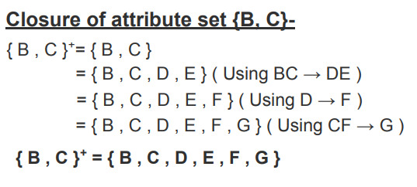
Computing the Closure of Attributes - Example

Slide 42
How to Find Candidate Key from Functional Dependencies
Candidate Key
  In a relational model, the set of those attributes which can be used to identify each row uniquely is called super keys, and there can be a lot of super keys. Those super keys which have no proper subset as any super key then it is called a candidate key.
  For example, in a relational model, we have three attributes as {A, B, C} and {AB} can identify a complete table, and {A} itself can identify the whole table then AB and A both will be super key, but A will be candidate key
Closure
  Attribute closure of an attribute can be identified as the set of attributes that can be functionally determined from it Closures will be used to find out the candidate key using functional dependencies.

Slide 43
How to Find Candidate Key from Functional Dependencies
Steps to find out the Candidate Key of a Relational Table using Functional Dependencies
Step 1:
  First, we will find out the essential and non-essential sets of attributes from the given set of attributes.
  Those attributes which are dependent on other attributes are non-essential attributes (Right-Hand Side (RHS)) , and their values can be found out using essential attributes.
  essential = R - non-essential
  So, all the essential attributes will definitely be part of our candidate key.
Step 2:
  We will combine all the essential attributes, and if they can determine all the attributes (by finding their closure), then it will be the candidate key.
Step 3:
  If a combination of essential attributes is not a candidate key, then we will try different combinations of essential and non-essential attributes which are not subset of each other to find out all the candidate keys.

Slide 44
How to Find Candidate Key from Functional Dependencies
Example 1:
Let's suppose we have a set of attributes as S: {A, B, C, D} and functional dependencies are:
  A -> B
  B -> C
  C -> A
Solution:
  In the above example, we have non-essential attributes as {A, B, C}, and the essential attribute is {D}.
  So, D will be the part of the candidate key.
  Closure of D: {D}
  So, a combination of essential attributes is not able to find all the attributes, so we will add non-essential attributes in different ways to find out the candidate keys.
  Closure of (AD) = {A, B, C, D} (using A->B and B->C)
  So, AD will be a candidate key.
  Closure of (BD) = {A, B, C, D} (using C->A and B->C)
  So, BD will be a candidate key.
  Closure of (CD) = {A, B, C, D} (using C->A and A->B)
  So, CD will be a candidate key.
  No other combination of attributes is not possible, so candidate keys are {AD, BD, CD}

Slide 45
How to Find Candidate Key from Functional Dependencies
Example 2:
Let's suppose we have a set of attributes as S: {A, B, C, D, E, F} and functional dependencies are:
  AB -> C
  B -> AE
  C -> D
Solution:
  In the above example, we have non-essential attributes as {A, C, D, E}, and the essential attribute is {B, F}.
  So, BF will be the part of the candidate key.
  Closure of BF: {B, A, E, C, D, F}
  Since the combination of essential attributes is capable of finding all the attributes, it will be a candidate key. All other combinations of the essential and non-essential attributes will not be minimal, so there will be only one candidate key as {BF}.

Slide 46
How to Find Candidate Key from Functional Dependencies
Example 3:
Let's suppose we have a set of attributes as S: {A, B, C, D, E} and functional dependencies are:F}.
CE -> D
D -> B
C -> A
Solution:
  In the above example, we have non-essential attributes as {A, B, D}, and the essential attribute is {C, E}.
  So, CE will be the part of the candidate key.
  Closure of CE: {C,E,D,B,A} using (CE->D, D->B and C->A)
  Since the combination of essential attributes is capable of finding all the attributes, it will be a candidate key. All other combinations of the essential and non-essential attributes will not be minimal, so there will be only one candidate key as {CE}.

Slide 47
How to Find Candidate Key from Functional Dependencies
Example 4:
Let's suppose we have a set of attributes as S: {W, X, Y, Z} and functional dependencies are:
  Z -> W
  Y -> XZ
  XW -> Y
Solution:
  In the above example, we have non-essential attributes as {W, X, Y, Z}, and the essential attribute is {}.
  In this example, we will explore each and every combination of attributes to find out the candidate key, as there is no essential attribute.
  Closure of W = {W}
  Closure of X = {X}
  Closure of Y = {Y,X,Z,W} (using Y->XZ and Z->W)
  Closure of Z = {Z}
  Since Y is capable of finding all the attributes so it will be a candidate key. Y will not be part of the next combinations.
  Closure of XW = {X,W,Y,Z} (using XW->Y and Y->XZ)
  Closure of ZW = {Z,W}
  Closure of XZ = {X,W,Y,Z} (using Z->W and XW->Y)
  So XW and XZ will be the next candidate keys, and the next other combinations will contain no attributes apart from these candidate keys.
  So there will be three candidate keys which are {Y, XW, XZ}

Slide 48
The Data Normalization Process
A methodology for organizing attributes into tables so that redundancy among the nonkey attributes is eliminated.
The output of the data normalization process is a properly structured relational database.
7-<number>

Slide 49
Levels of Normalization
Levels of normalization based on the amount of redundancy in the database.
Various levels of normalization are:
  First Normal Form (1NF)
  Second Normal Form (2NF)
  Third Normal Form (3NF)
  Boyce-Codd Normal Form (BCNF)
  Fourth Normal Form (4NF)
  Fifth Normal Form (5NF)
  Domain Key Normal Form (DKNF)
Redundancy
Number of Tables
Complexity
Most databases should be 3NF or BCNF in order to avoid the database anomalies.

Slide 50
Levels of Normalization
1NF
2NF
3NF
4NF
5NF
DKNF
Each higher level is a subset of the lower level

Slide 51
Functional Dependence
Salesperson Number Number
eSalesperson Name me
Salesperson Number is the determinant.
The value of Salesperson Number determines the value of Salesperson Name.
Salesperson Name is functionally dependent on Salesperson Number.
7-<number>

Slide 52
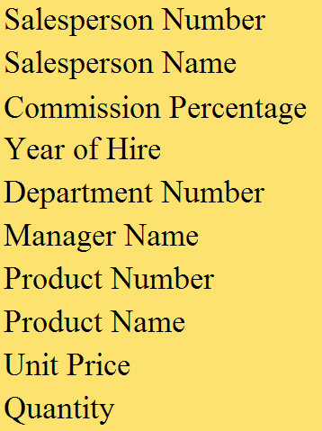
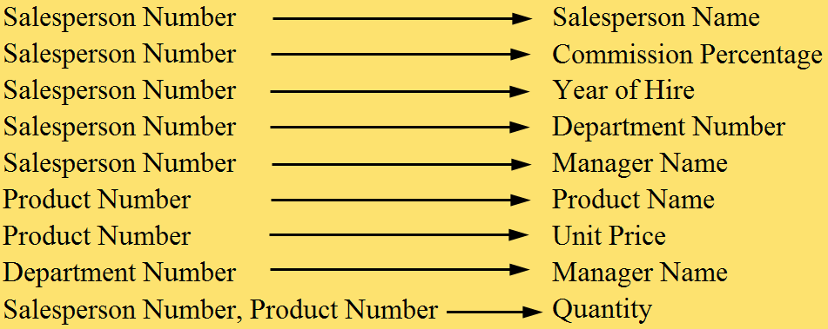
General Hardware Environment: SALESPERSON and PRODUCT
7-<number>

Slide 53
Steps in the Data Normalization Process
First Normal Form
Second Normal Form
Third Normal Form
7-<number>

Slide 54
The Data Normalization Process
Once the attributes are arranged in third normal form, the group of tables that they comprise is a well-structured relational database with no data redundancy.
A group of tables is said to be in a particular normal form if every table in the group is in that normal form.
The data normalization process is progressive.
  For example, if a group of tables is in second normal form, it is also in first normal form.
7-<number>

Slide 55

General Hardware Company: Unnormalized Data
Records contain multivalued attributes.
7-<number>

Slide 56

General Hardware Company: First Normal Form
The attributes under consideration have been listed in one table, and a primary key has been established.
The number of records has been increased so that every attribute of every record has just one value.
The multivalued attributes have been eliminated.
7-<number>

Slide 57
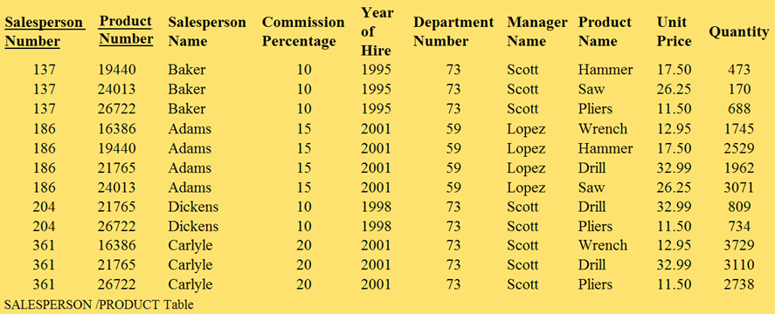
General Hardware Company: First Normal Form
7-<number>

Slide 58
General Hardware Company: First Normal Form
First normal form is merely a starting point in the normalization process.
First normal form contains a great deal of data redundancy.
  Three records involve salesperson 137, so there are three places in which his name is listed as Baker, his commission percentage is listed as 10, and so on.
  Two records involve product 19440 and this product’s name is listed twice as Hammer and its unit price is listed twice as 17.50.
7-<number>

Slide 59
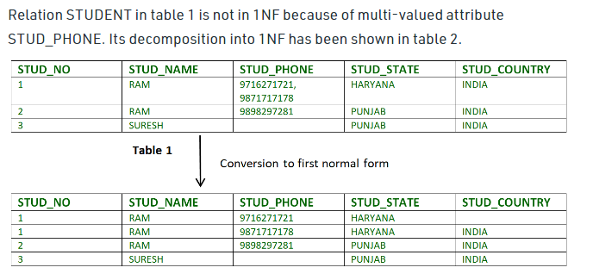
First Normal Form (1NF)
If a relation contains a composite or multi-valued attribute, it is first normal form,
A relation is in first normal form if it does not contain any composite or multi-valued attribute.
A relation is in first normal form if every attribute in that relation is singled valued attribute.
A table is in 1 NF iff:
  There are only Single Valued Attributes.
  Attribute Domain does not change.
  There is a unique name for every Attribute/Column.
  The order in which data is stored does not matter.

Slide 60
Second Normal Form (2NF)
(1NF)
  does not eliminate redundancy, but rather, it’s that it eliminates repeating groups
  Instead of having multiple columns of the same kind of data in a record, (0NF or Unnormalized form) you remove the repeated information into a separate relation and represent them as rows. This is what constitutes 1NF.
(2NF)
    Second Normal Form (2NF) is based on the concept of full functional dependency.
    (2NF) applies to relations with composite keys, that is, relations with a primary key composed of two or more attributes.
    A relation with a single-attribute primary key is automatically in at least 2NF..
    To be in second normal form,
      a relation must be in first normal form
      and relation must not contain any partial dependency.
      A relation is in 2NF if it has No Partial Dependency, i.e., no non-prime attribute (attributes which are not part of any candidate key) is dependent on any proper subset of any candidate key of the table.

Slide 61
Second Normal Form (2NF)
  A relation that is in First Normal Form and every non-primary-key attribute is fully functionally dependent on the primary key, then the relation is in Second Normal Form (2NF)
  Note – If the proper subset of candidate key determines non-prime attribute, it is called partial dependency
  The normalization of 1NF relations to 2NF involves the removal of partial dependencies. If a partial dependency exists, we remove the partially dependent attribute(s) from the relation by placing them in a new relation along with a copy of their determinant.

Slide 62
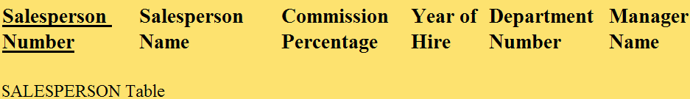
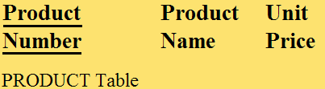

General Hardware Company: Second Normal Form
In SALESPERSON, Salesperson Number is primary key attribute. Every nonkey attribute of the table is fully defined just by Salesperson Number.
Similar logic for PRODUCT and QUANTITY tables.
7-<number>

Slide 63
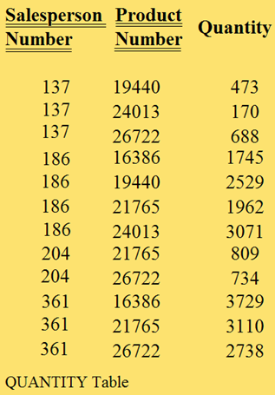
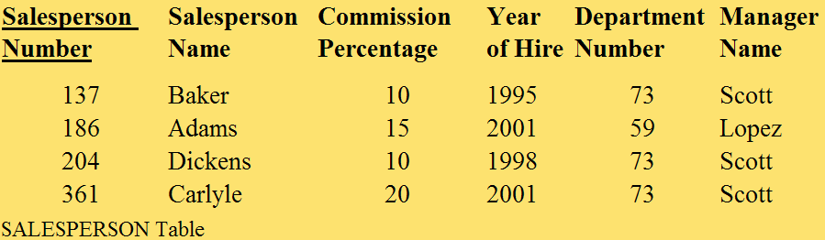
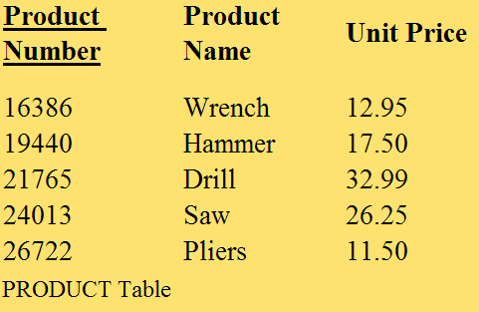
General Hardware Company: Second Normal Form
7-<number>

Slide 64
General Hardware Company: Third Normal Form
Does not allow transitive dependencies in which one nonkey attribute is functionally dependent on another.
Nonkey attributes are not allowed to define other nonkey attributes.
7-<number>

Slide 65
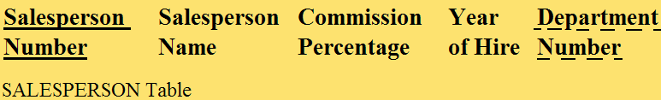

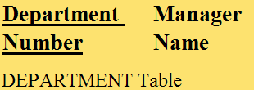

General Hardware Company: Third Normal Form
7-<number>

Slide 66
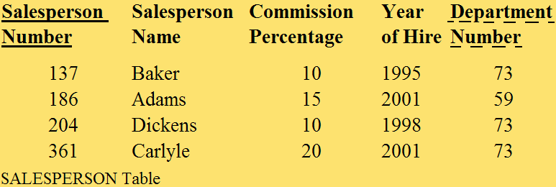
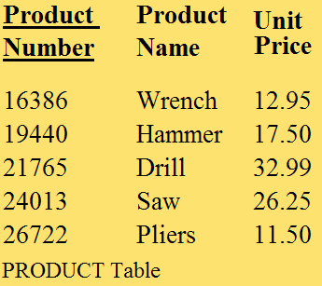
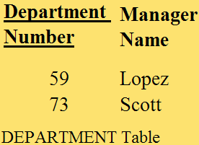
General Hardware Company: Third Normal Form
7-<number>

Slide 67
General Hardware Company: Third Normal Form
Important points about the third normal form structure are:
  It is completely free of data redundancy.
  All foreign keys appear where needed to logically tie together related tables.
  It is the same structure that would have been derived from a properly drawn entity-relationship diagram of the same business environment.
7-<number>

Slide 68
Boyce-Codd normal form
“Represent Every Fact Only ONCE”
A relation R with FDs F is said to be in Boyce-Codd normal form (BCNF) if for all X→A in F⁺ then
  Either A∈X (‘trivial dependency’), or
  X is a superkey for R
  We say that a dependency A₁A₂…A_{n}→B₁B₂…B_{m} is:
    Trivial if the B’s are subset of A’s.
  Decomposition for BCNF
    If X->Y violates BCNF then divide R into R1(X, Y) and R2(R-Y)

Slide 69
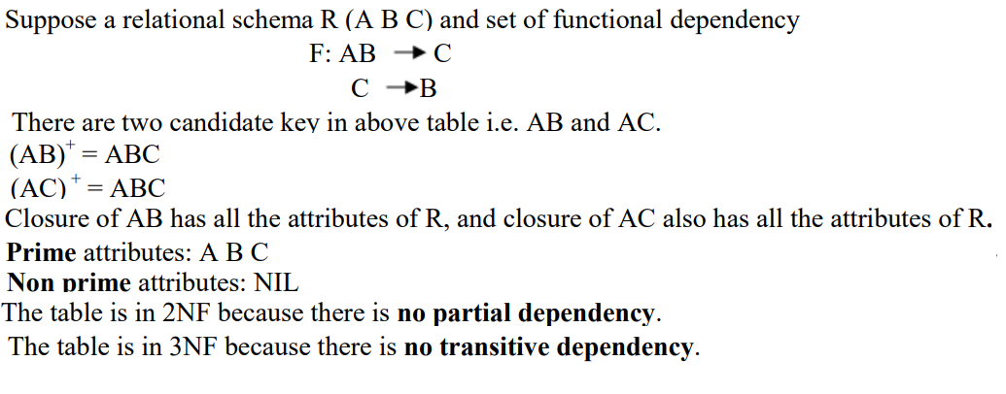



Slide 70
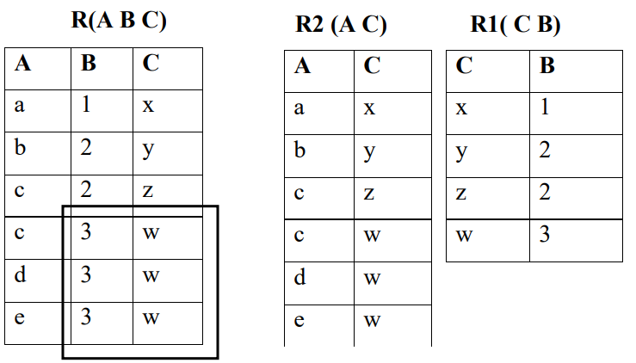

Slide 71
BCNF: Example
Consider R=R(city, street&no, zipcode) with FDs:
  city,street&no → zipcode
  zipcode → city
This is not in BCNF, because zipcode is not a superkey for R
  R1 (zipcode, city)
  R2 (street&no, zipcode)

Slide 72
BCNF: Example
Consider a relation R with attributes (student, subject, teacher).
  F: { (student, Teacher) -> subject
  (student, subject) -> Teacher
  Teacher -> subject}
The above relation is in 3NF [since there is no transitive dependency]. A relation R is in BCNF if for every non-trivial FD X->Y, X must be a superkey.
The above relation is not in BCNF, because in the FD (teacher->subject), teacher is not a superkey.
So R is divided into two relations R1(Teacher, subject) and R2(student, Teacher).

Slide 73
MULTIVALUED DEPENDENCY AND FOURTH NORMAL FORM (4NF)
Multivalued Dependency
  Multivalued dependency occurs when two attributes in a table are independent of each other but, both depend on a third attribute
  A multivalued dependency consists of at least two attributes that are dependent on a third attribute that's why it always requires at least three attributes.
  MVD or multivalued dependency means that for a single value of attribute ‘a’ multiple values of attribute ‘b’ exist. We write it as,
    a --> --> b
    It is read as a is multi-valued dependent on b
Salesperson Name

Slide 74
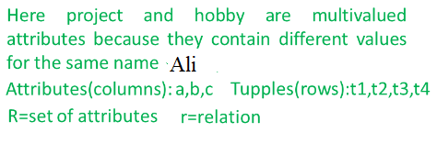
MULTIVALUED DEPENDENCY AND FOURTH NORMAL FORM (4NF)
Multivalued Dependency
  Suppose a person named Ali is working on 2 projects Microsoft and Oracle and has 2 hobbies namely Reading and Music. This can be expressed in a tabular format in the following way.
Salesperson Name
 | a | b | c
 | Name | Project | Hobby
T1 | Ali | MS | Reading
T2 | Ali | Oracle | Music
T3 | Ali | MS | Music
T4 | Ali | Oracle | Reading

Slide 75
MULTIVALUED DEPENDENCY AND FOURTH NORMAL FORM (4NF)
Multivalued Dependency
  We can say that multivalued dependency exists if the following conditions are met.
  Conditions for MVD
    Any attribute say a multiple define another attribute b; if any legal relation r(R), for all pairs of tuples t1 and t2 in r, such that,
      t1[a] = t2[a]
      Then there exists t3 and t4 in r such that.
      t1[a] = t2[a] = t3[a] = t4[a]
      t1[b] = t3[b]; t2[b] = t4[b]
      t1 = t4; t2 = t3
Salesperson Name

Slide 76
MULTIVALUED DEPENDENCY AND FOURTH NORMAL FORM (4NF)
 | a | b | c
 | Name | Project | Hobby
T1 | Ali | MS | Reading
T2 | Ali | Oracle | Music
T3 | Ali | MS | Music
T4 | Ali | Oracle | Reading
Multivalued Dependency
Condition-1 for MVD
  t1[a] = t2[a] = t3[a] = t4[a] Finding from table,
  t1[a] = t2[a] = t3[a] = t4[a] = Ali So, condition 1 is Satisfied.
Condition-2 for MVD
    t1[b] = t3[b] And t2[b] = t4[b] Finding from table,
    t1[b] = t3[b] = MS And t2[b] = t4[b] = Oracle So, condition 2 is Satisfied.
  Condition-3 for MVD
    ∃c ∈ R-(a ∪ b) where R is the set of attributes in the relational table.
    t1 = t4 And t2=t3 Finding from table, t1 = t4 = Reading And t2 = t3 = Music
    So, condition 3 is Satisfied. All conditions are satisfied, therefore,
    a --> --> b According to table we have got, name --> --> project
    And for, a --> --> C We get, name --> --> hobby
    Hence, we know that MVD exists in the above table and it can be stated by,
    name --> --> project
    name --> --> hobby
Salesperson Name

Slide 77
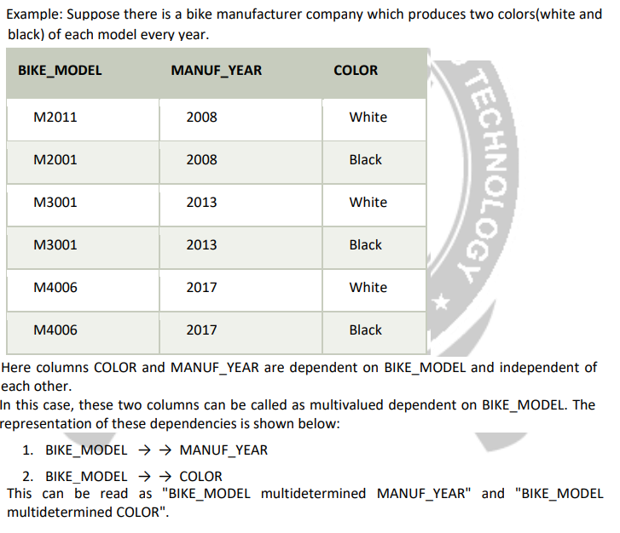

Slide 78
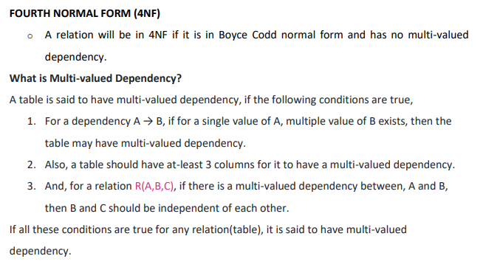
MULTIVALUED DEPENDENCY AND FOURTH NORMAL FORM (4NF)
Salesperson Name

Slide 79

MULTIVALUED DEPENDENCY AND FOURTH NORMAL FORM (4NF)
Salesperson Name

Slide 80

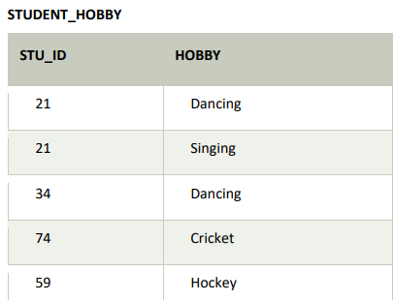
MULTIVALUED DEPENDENCY AND FOURTH NORMAL FORM (4NF)
Salesperson Name

Slide 81
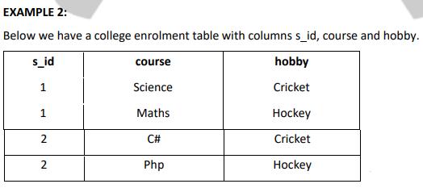
MULTIVALUED DEPENDENCY AND FOURTH NORMAL FORM (4NF)
Salesperson Name

Slide 82

MULTIVALUED DEPENDENCY AND FOURTH NORMAL FORM (4NF)
Salesperson Name

Slide 83
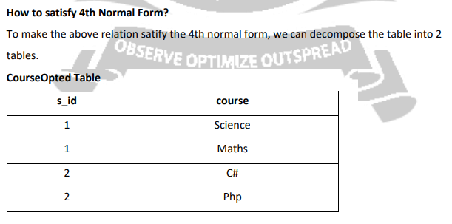
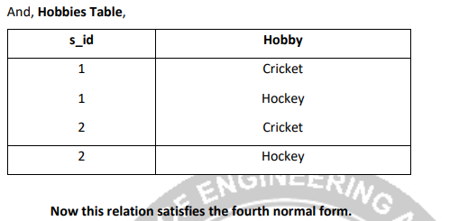
MULTIVALUED DEPENDENCY AND FOURTH NORMAL FORM (4NF)
Salesperson Name

